Slide 1
Mathematical Economics
Lecture 4

Slide 2
Plan
Continuity in Metric Spaces
Continuity at a point
Continuity
Uniform continuity
Lipschitz

Slide 3

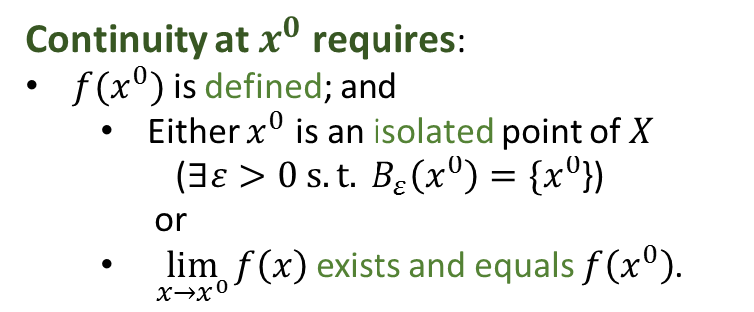




Continuity
Let ($X,d$) and $(Y,ρ)$ be two metric spaces. A function $f:X→Y$ is continuous at a point $x^{0}$ if
$$∀ε>0 ∃δ>0 s.t. if d\left(x,x^{0}\right)<δ, then ρ\left(f\left(x\right),f\left(x^{0}\right)\right)<ε.$$
Note: $δ$can be different for different $x^{0}$ and $ε.$
Continuity at $x^{0}$ requires:
${f(x}^{0})$ is defined; and
Either $x^{0}$ is an isolated point of $X$
($∃ε>0 s.t. B_{ε}\left(x^{0}\right)=\{x^{0}$})
or
$\lim_{x→x^{0}}{f\left(x\right)}$ exists and equals $f\left(x^{0}\right)$.
$$B_{ε}\left(x^{0}\right)$$
$${f(x}^{0})$$
$$δ$$
$$x^{0}$$

Slide 4
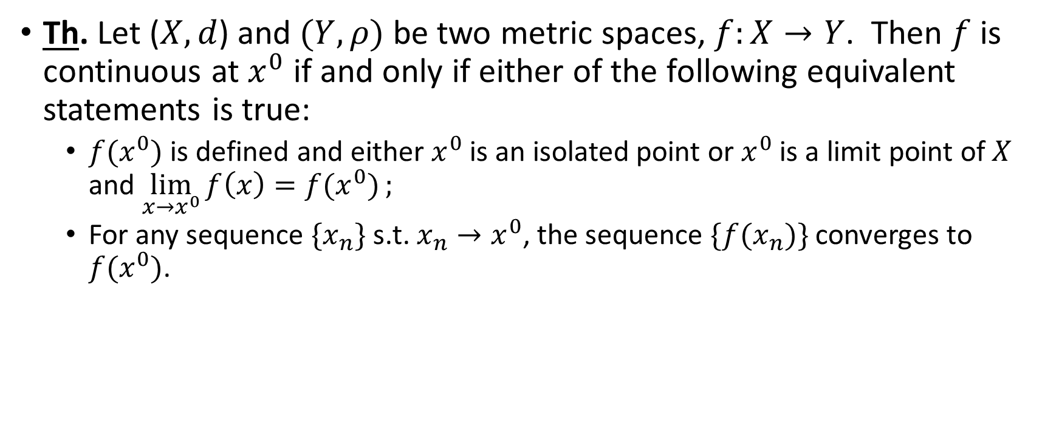
Continuity: Alternative Definition
Th. Let ($X,d$) and $(Y,ρ)$ be two metric spaces, $f:X→Y$. Then $f$ is continuous at $x^{0}$ if and only if either of the following equivalent statements is true:
${f(x}^{0})$ is defined and either $x^{0}$ is an isolated point or $x^{0}$ is a limit point of $X$ and $\lim_{x→x^{0}}{f\left(x\right)=f(x^{0})};$
For any sequence $\{x_{n}\}$ s.t. $x_{n}→x^{0}$, the sequence $\{{f(x}_{n})\}$ converges to ${f(x}^{0})$.

Slide 5
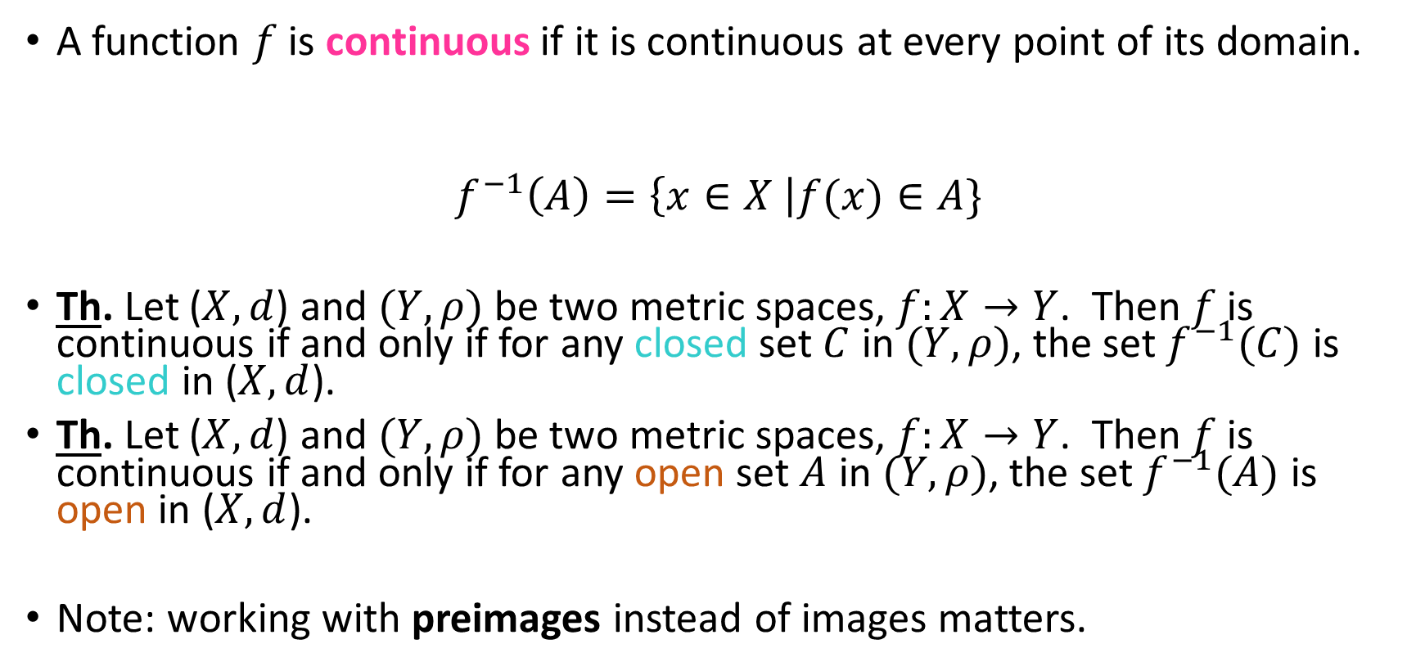
Continuity in Terms of Open and Closed Sets
A function $f$ is continuous if it is continuous at every point of its domain.
$$f^{−1}\left(A\right)=\left\{x∈X \right|f(x)∈A\}$$
Th. Let ($X,d$) and $(Y,ρ)$ be two metric spaces, $f:X→Y$. Then $f$ is continuous if and only if for any closed set $C$ in $(Y,ρ)$, the set $f^{−1}(C)$ is closed in ($X,d$).
Th. Let ($X,d$) and $(Y,ρ)$ be two metric spaces, $f:X→Y$. Then $f$ is continuous if and only if for any open set $A$ in $(Y,ρ)$, the set $f^{−1}(A)$ is open in ($X,d$).
Note: working with preimages instead of images matters.

Slide 6
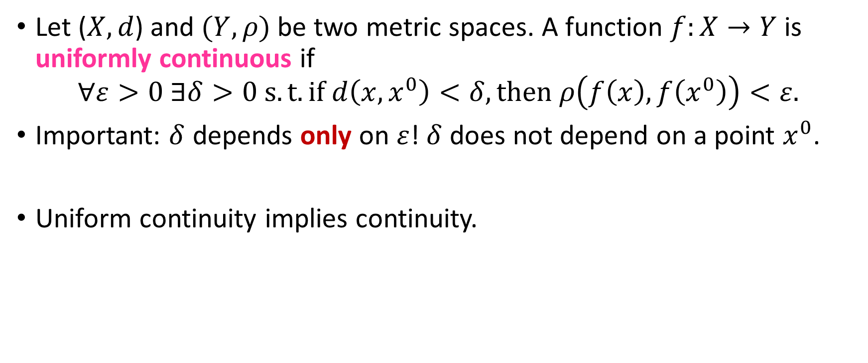
Uniform Continuity
Let ($X,d$) and $(Y,ρ)$ be two metric spaces. A function $f:X→Y$ is uniformly continuous if
$$∀ε>0 ∃δ>0 s.t. if d\left(x,x^{0}\right)<δ, then ρ\left(f\left(x\right),f\left(x^{0}\right)\right)<ε.$$
Important: $δ$ depends only on $ε$! $δ$ does not depend on a point $x^{0}$.
Uniform continuity implies continuity.

Slide 7
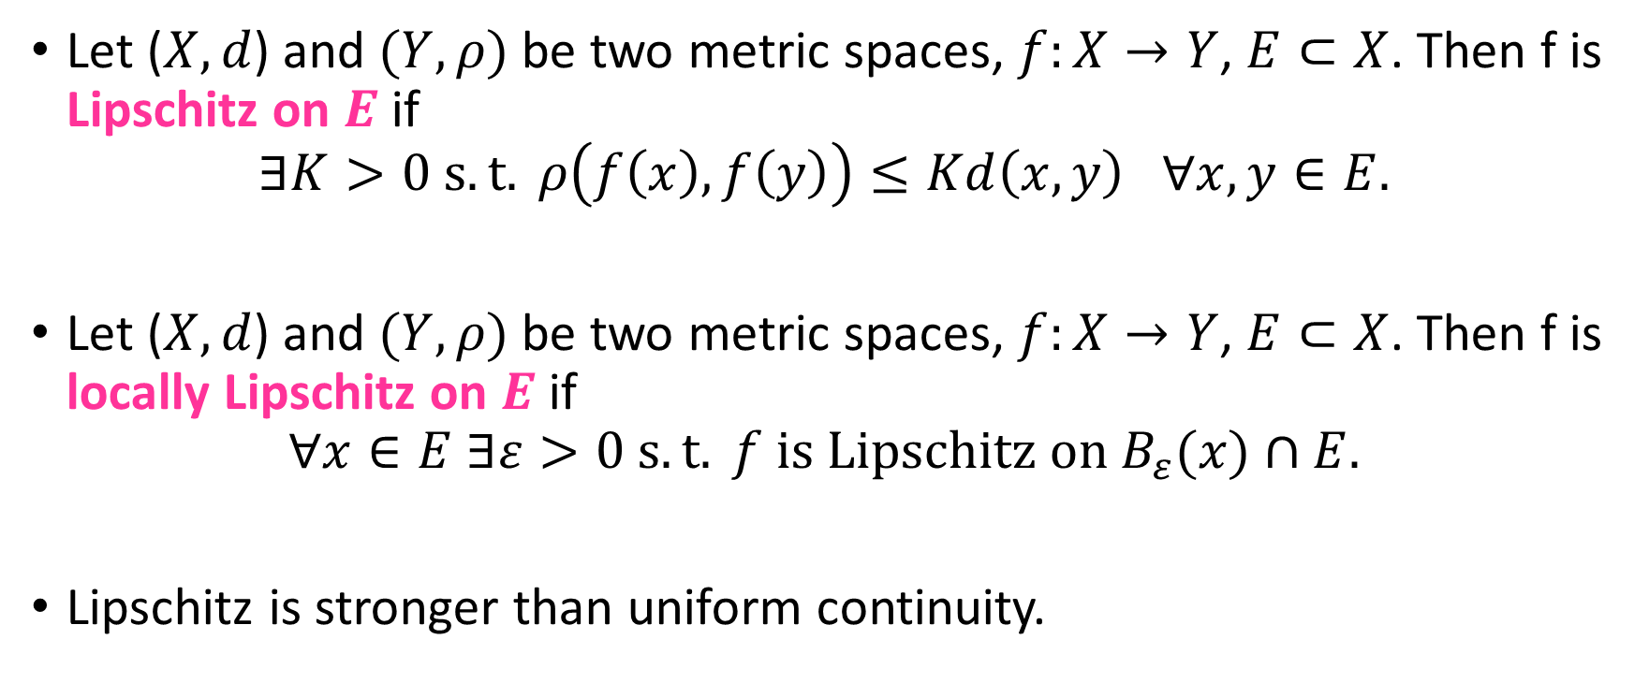
Lipschitz
Let ($X,d$) and $(Y,ρ)$ be two metric spaces, $f:X→Y$, $E⊂X$. Then f is Lipschitz on $E$ if
$$∃K>0 s.t. ρ\left(f\left(x\right),f\left(y\right)\right)≤Kd\left(x,y\right) ∀x,y∈E.$$
Let ($X,d$) and $(Y,ρ)$ be two metric spaces, $f:X→Y$, $E⊂X$. Then f is locally Lipschitz on $E$ if
$$∀x∈E ∃ε>0 s.t. f is Lipschitz on B_{ε}(x)∩E.$$
Lipschitz is stronger than uniform continuity.

